Slide 1
Current state on merged ontology INDL + NDL-OWL
Thijs Walcarius Brecht Vermeulen Wim Vandenberghe
December 5th, 2013

Slide 2
Table of contents
Why do this exercise?
What is INDL and NDL-OWL?
Necessary steps for the use of INDL
Merge methodology
Overview of result
Overall structure
Handover between network and computing infrastruture layer

Slide 3
Why doing this exercise?
November 22: first GENI-FIRE telco about design of an upper ontology to describe federated resources
INDL was identified as a good starting point to describe network and computing resources
Import concepts as needed to complete ontology

Slide 4
INDL: overview
Infrastructure Definition Language
Created by UvA, in parallel with GEYSERS and NOVI
Barebone description of (virtualized) computing infrastructure and capabilities of resources
Can be used stand-alone or in combination with NML
Notes:
Emphasis on “in parallel”: not an integral part of GEYSERS, nor NOVI

Slide 5
NDL-OWL
Network Description Language
Created in ORCA-project of RENCI (GENI)
Very extensive ontology that includes ao. a resource description model based on NDL
NDL is predecessor of NML
➔ Good resource to identify missing concepts

Slide 6
Situating INDL and NDL-OWL
NDL
NDL-OWL
NOVI
NML
INDL
GEYSERS
Notes:
NDL: started in 2005
NML: started in 2007, completed in 2013
INDL: started in 2012

Slide 7
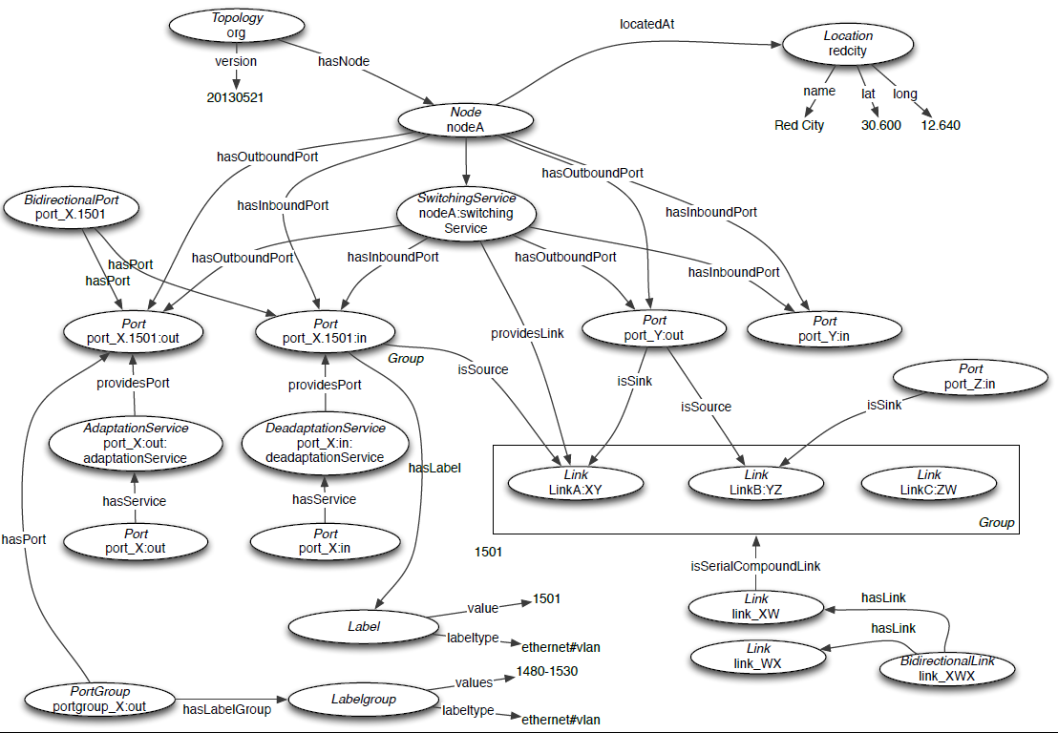
Overview of NML-Base

Slide 8
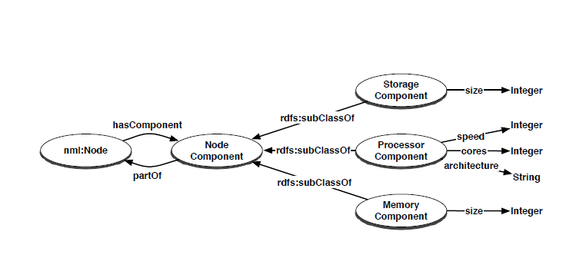
Overview of INDL

Slide 9
Necessary steps for the use of INDL
Formal definition of the concepts introduced in INDL.
Reorganization of classes:
Removing Double definition of class Node:
Thing → Node
Thing → NetworkObject → Node
Property-classes need an own parent class:
Thing → |  | Architecture Capability Instructionset
 | Feature →

Slide 10
class Node: Issue
Ambigious definition of class Node
NML-Base: “A Node is generally a device connected to, or part of, the network. A Node does not necessarily correspond to a physical machine.”
INDL: Node seems to be used as upper class for computers/servers
What to do with routers, switches,…?

Slide 11
class Node: Proposed solution
Creation of a subclass ComputeElement in the class Node
Question: Do we rename NodeComponent to ComputeElementComponent?
classes GraphicsComponent, StorageComponent, etc. don’t make much sense for non-computing nodes.

Slide 12
Merge methodology
Match concepts between NDL-OWL and INDL
Find the concepts are missing in INDL compared to NDL-OWL
Determine correct position in merged ontology
Rename concept to match INDL naming convention (CPU vs. Processor)

Slide 13
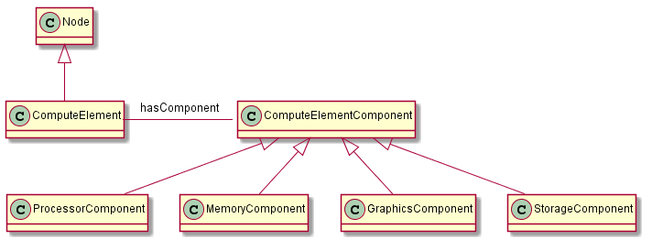
Overview of merged ontology
Definition of computing nodes and it’s components:

Slide 14
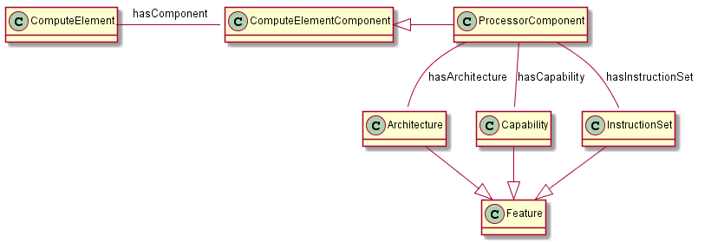
The use of features

Slide 15
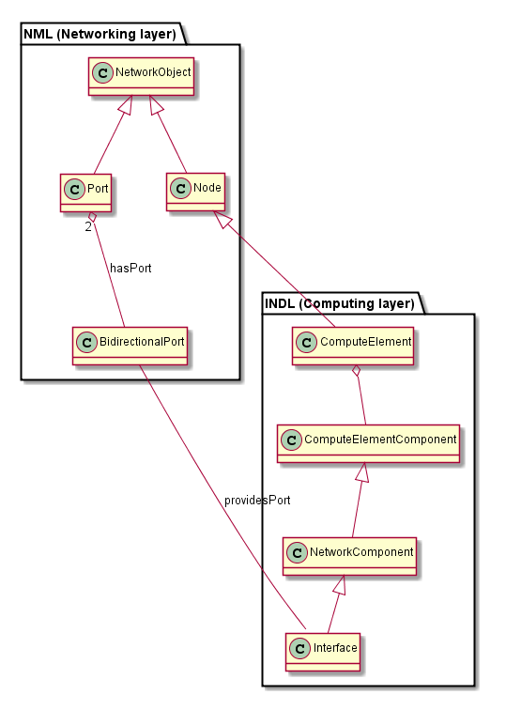
Handover between layers

Slide 16
Acknowledgement
This work was carried out with the support of the Fed4FIRE-project (“Federation for FIRE"), an Integrated project funded by the European Commission through the 7th ICT-Framework Programme. (318389). It does not necessarily reflect the views of the European Commission. The European Commission is not liable for any use that may be made of the information contained herein.
Notes:
THIS SLIDE SHOULD ALWAYS BE THE LAST SLIDE OF YOUR PRESENTATION!!!!

